Slide 1



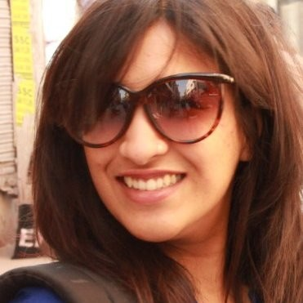

DBEI HACKATHON 2019

Slide 2
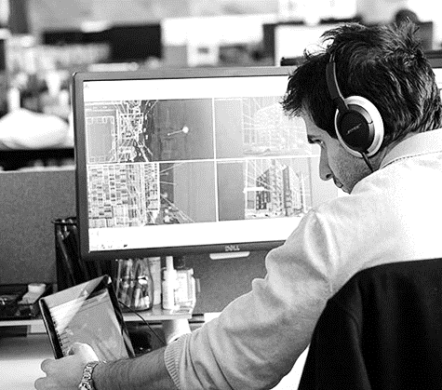
BUSINESS PROBLEM
Designers and engineers are not always aware of all the potential solutions to a clash and how each one impacts the cost, schedule, and quality of a project.
Notes:
So What do I do?

Slide 3

Introducing
Notes:
I’m so glad you asked!?!?!?!

Slide 4
OUR PROCESS
Generate Options
1
Clash Detection
Communicate resolution
2
3
Select Optimal Solution
Update Model
Notes:
Dan, will give you more specifics

Slide 5


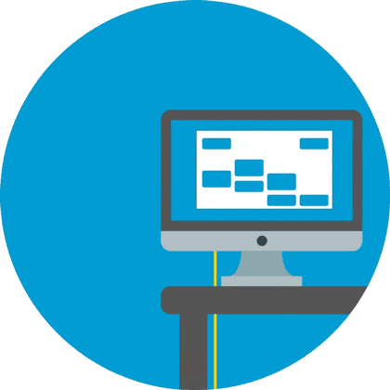
WHAT IS CLASH?
GENERATIVE DESIGN
MACHINE LEARNING
WEB-BASED APP
To create multiple solutions for clashes
To generate solutions and evaluation metrics
To bring the decision making to the users

Slide 6






TOOL WORKFLOW
Vue.js frontend
Rhino, pyRevit

Slide 7
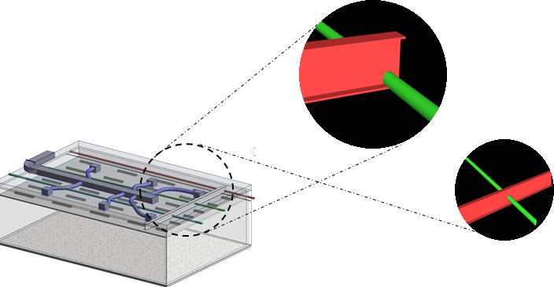
CLASH DETECTION
Notes:
We focused on one condition…

Slide 8
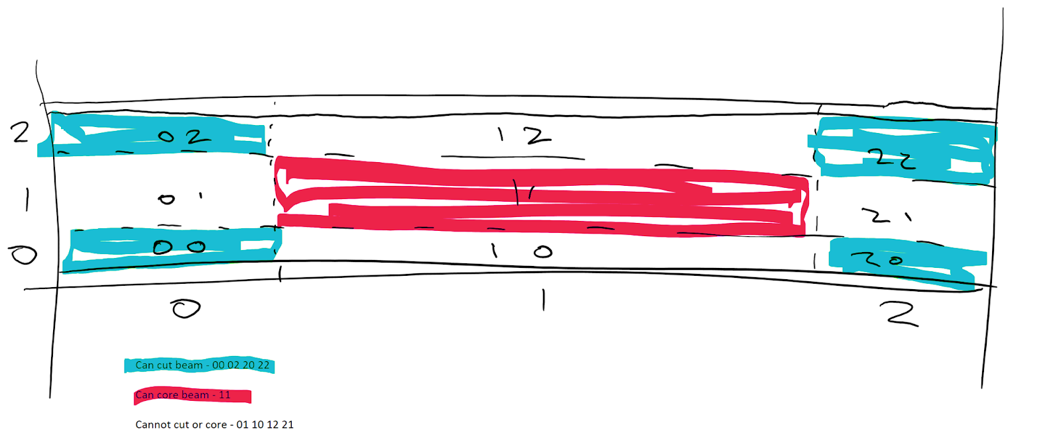
CLASH SKETCH
Notes:
Pragy’a will jump in

Slide 9
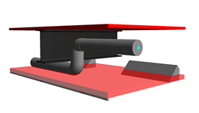
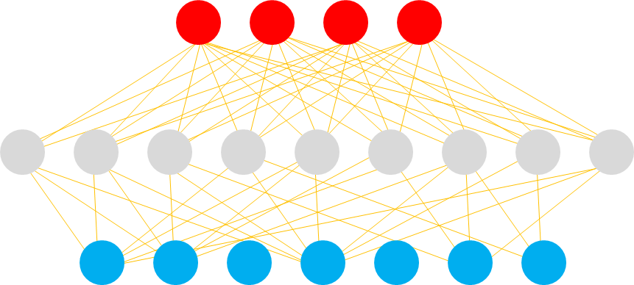
CLASH DETECTION
4 Pipe Types 9 Intersection Scenarios 7 Possible Solutions Multiple Phases

Slide 10
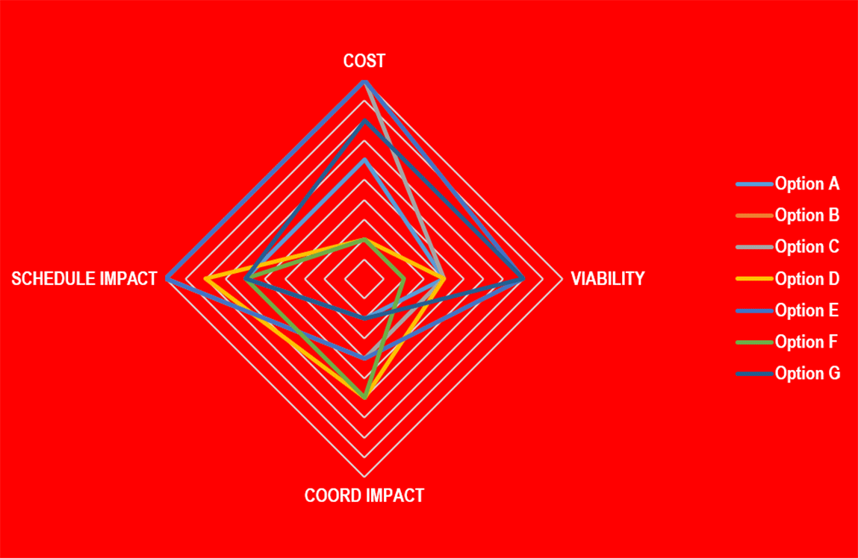
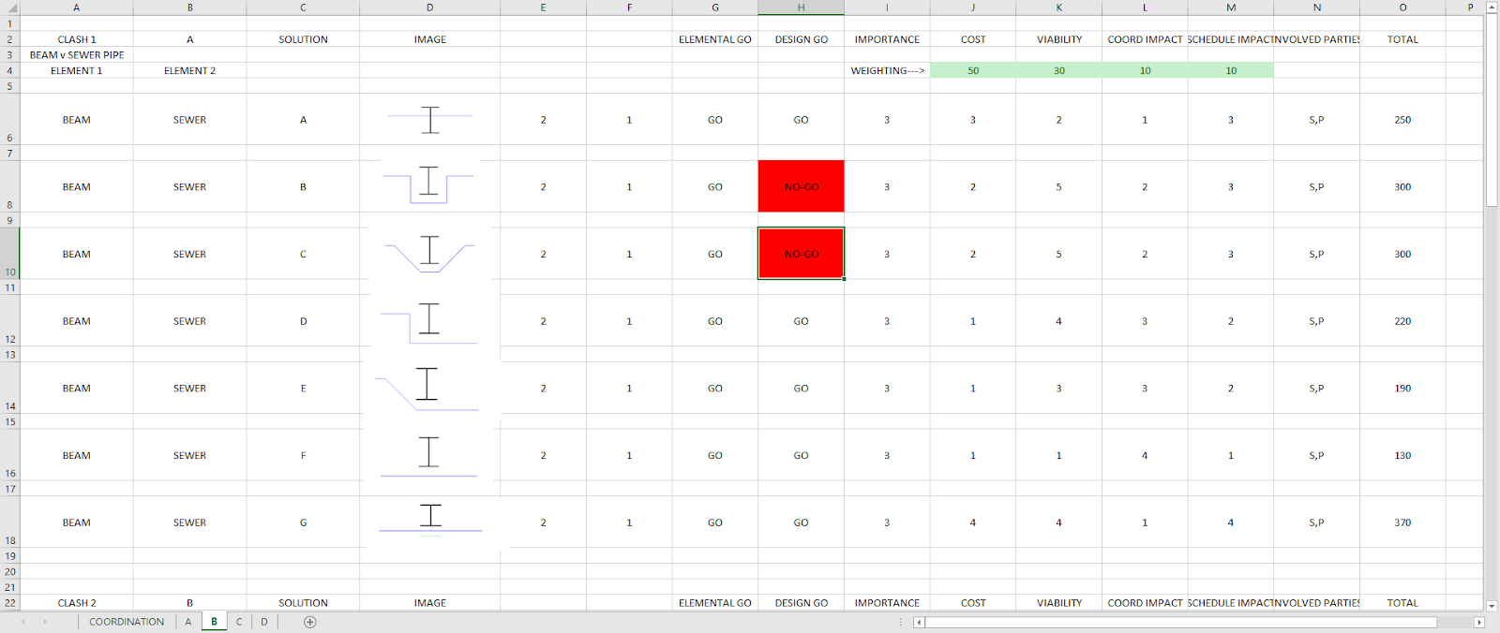
CLASH DETECTION

Slide 11
Now it’s time for a
DEMO

Slide 12
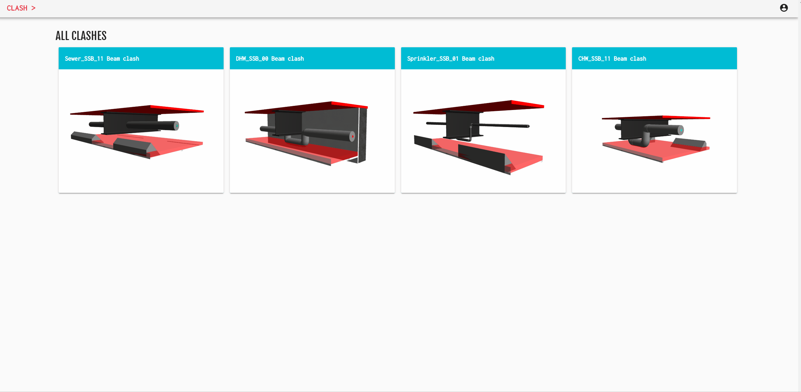
Notes:
Submit … to a database…

Slide 13
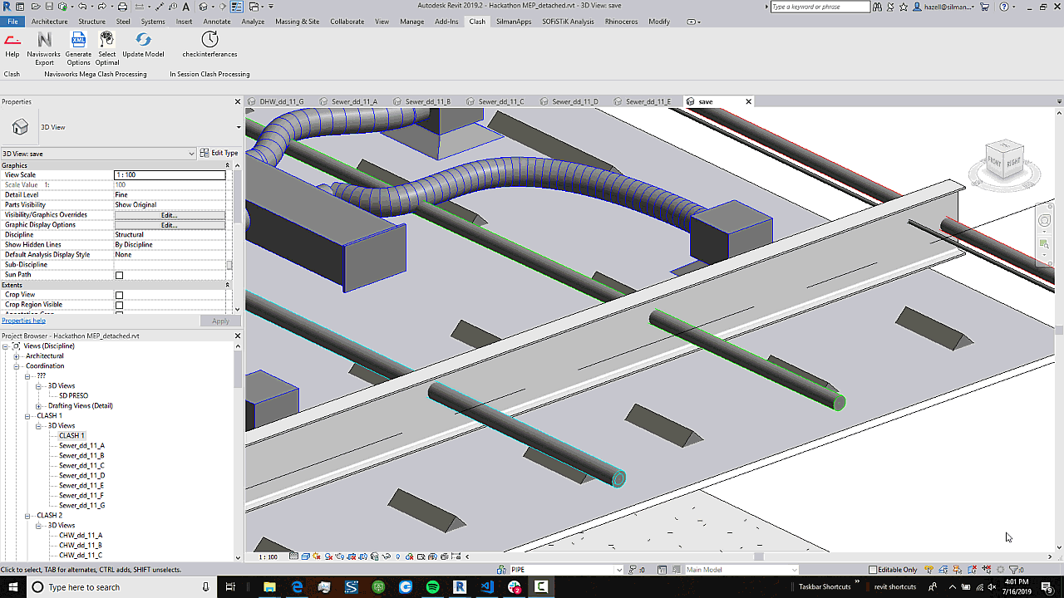
Notes:
Back at home,…

Slide 14



FUTURE POSSIBILITIES
Code requirements
Design criteria
Client awareness during option planning
Safety in design
Landscaping and infrastructure

Slide 15
THANK YOU
GitHub
http://github.com/clash-busters
Deployed Site
http://clashdbei.herokuapp.com

Slide 16
CREDITS
This is where you give credit to the ones who are part of this project.
Did you like the resources on this template? Get them for free at our other websites.
Presentation template by Slidesgo
Icons by Flaticon
Infographics by Freepik
Images created by Freepik
Author introduction slide photo created by Freepik
Text & Image slide photo created by Freepik.com

